Slide 1
CATERING SERVICE
MJ Padma Sri jxm166230
Vincy Shrine vxc152130

Slide 2
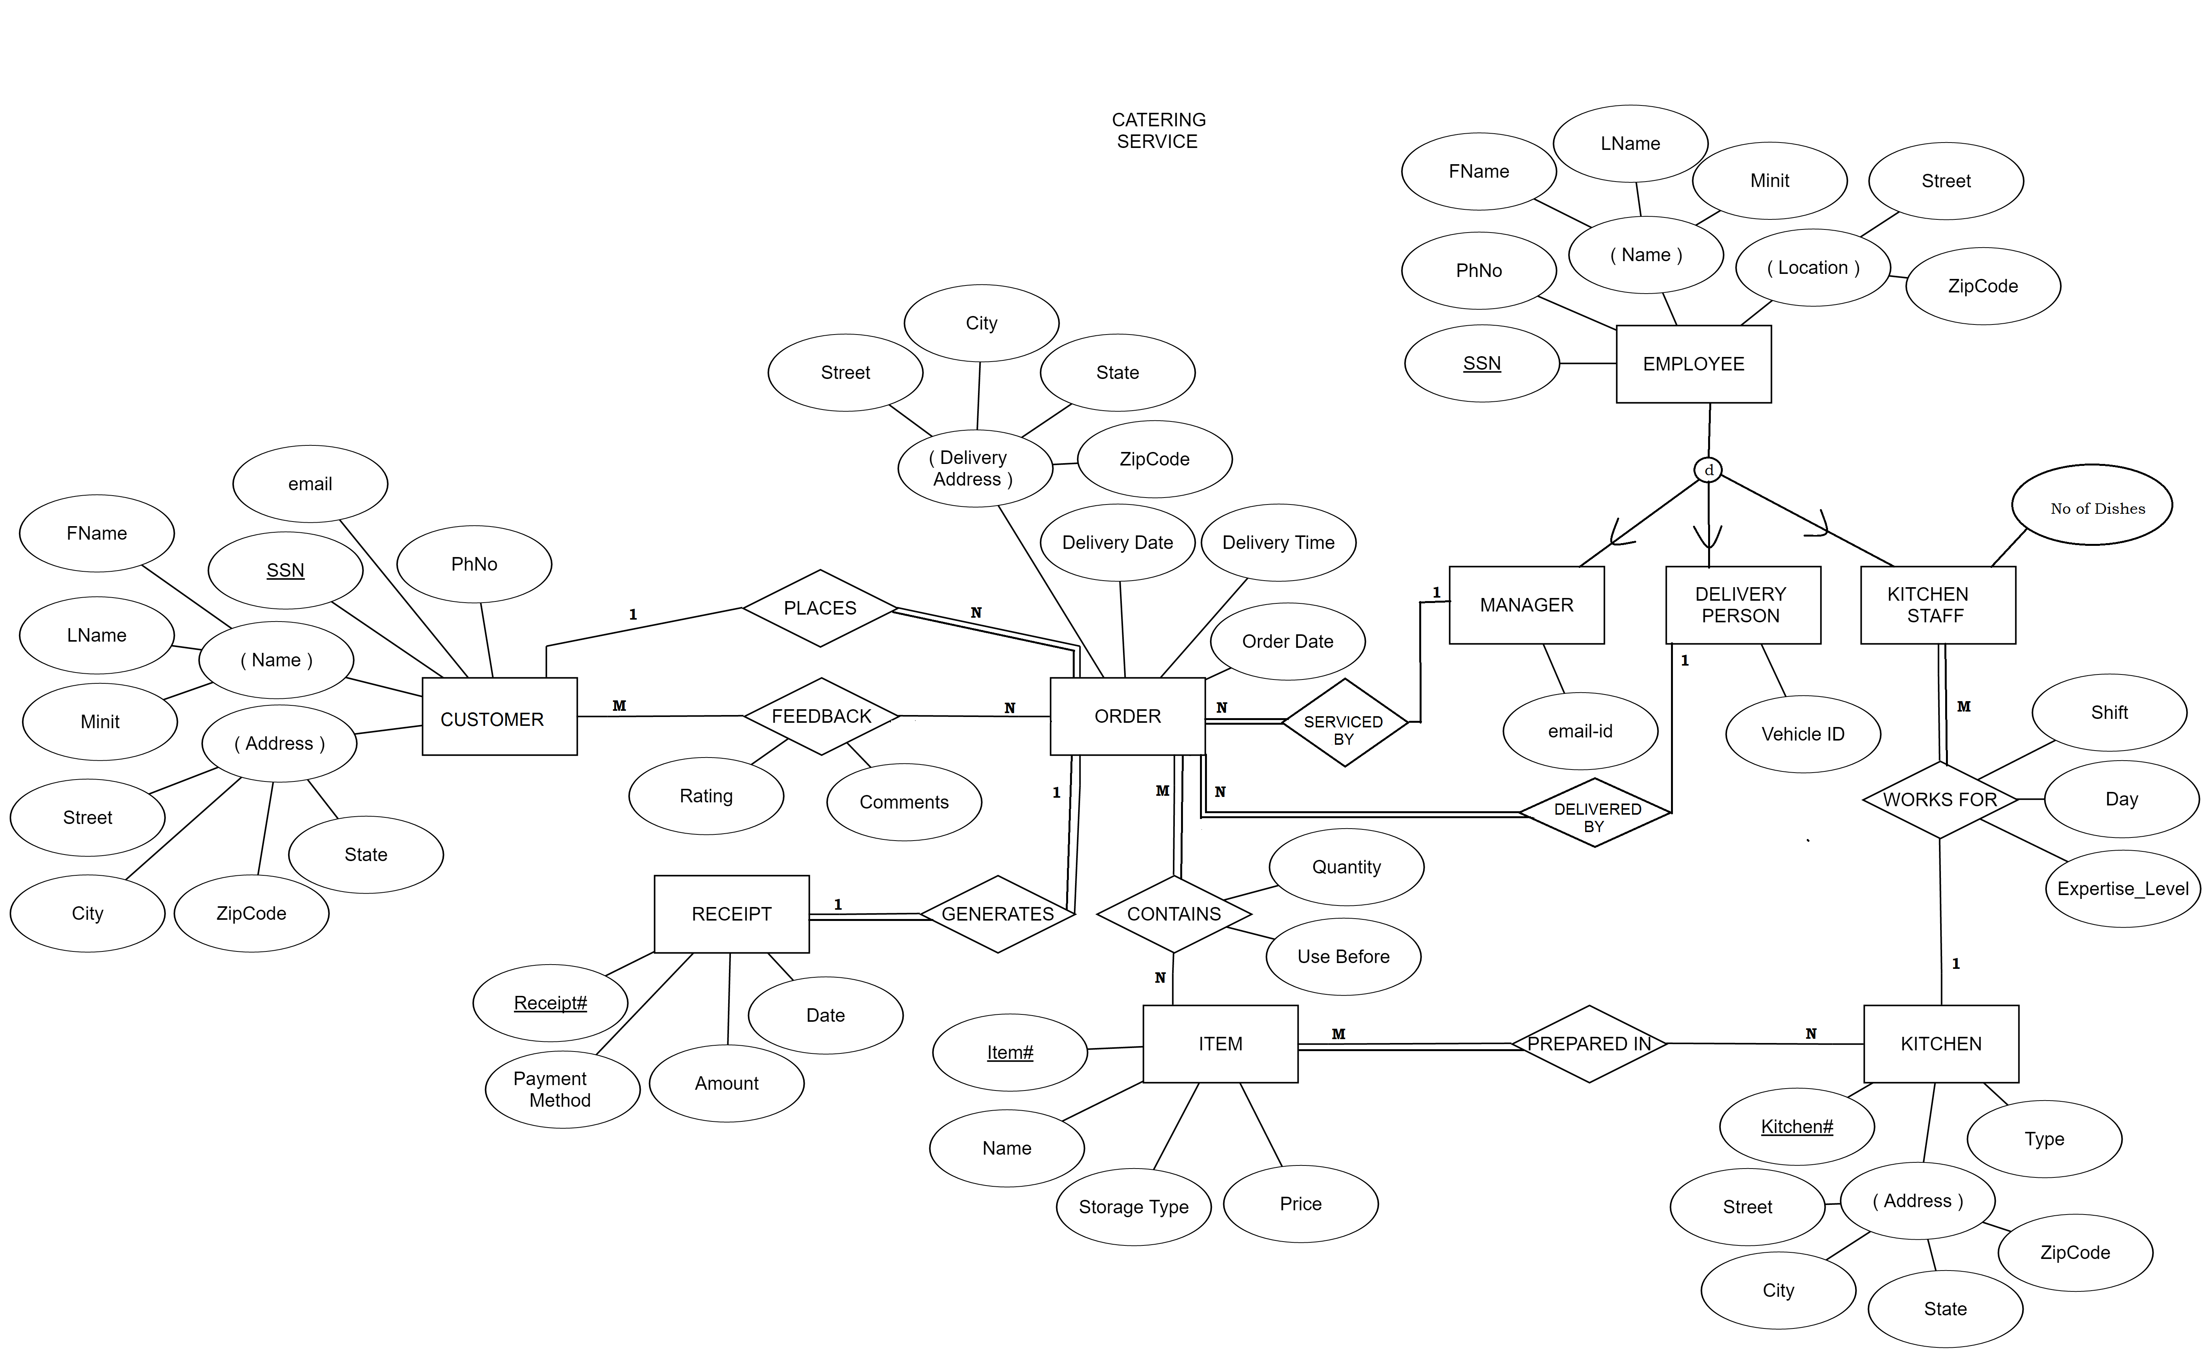
ER DIAGRAM

Slide 3
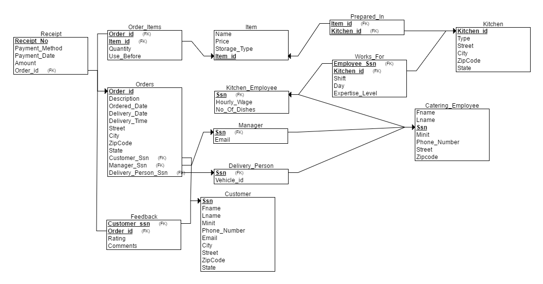
RELATIONAL SCHEMA

Slide 4
STORED PROCEDURES
GetTotalPrice
Given the orderId, computes the total cost of complete order, taking into account every item’s price and quantity.
Use_Before_Notification
Notifies the customer about items that are going to perish in the upcoming week, along with details on the number of remaining days.

Slide 5
Procedure to get the Total Price:
set SERVEROUTPUT ON;
DECLARE
totalPrice FLOAT;
PROCEDURE GetTotalPrice(
orderId IN VARCHAR2,
totalPrice OUT FLOAT)AS
thisOrderId ORDER_ITEMS.ORDER_ID%TYPE;
BEGIN
SELECT oi.order_id , SUM(oi.quantity * it.price) INTO thisOrderId, totalPrice
FROM ORDER_ITEMS oi, ITEM it
WHERE it.item_id = oi.item_id
GROUP BY oi.order_id;
END;
BEGIN
GetTotalPrice(101, totalPrice);
DBMS_OUTPUT.PUT_LINE('Order#'||101 ||' has total price: '|| totalPrice ||'$' );
END;

Slide 6
Procedure to get the customers to be notified:
set SERVEROUTPUT ON;
DECLARE
PROCEDURE Use_Before_Notification AS
thisFName CUSTOMER.FNAME%TYPE;
thisLName CUSTOMER.LNAME%TYPE;
thisItemName ITEM.NAME%TYPE;
thisOrderId ORDER_ITEMS.ORDER_ID%TYPE;
thisItemId ORDER_ITEMS.ITEM_ID%TYPE;
remaining_days NUMBER;
CURSOR UseBeforeCursor IS
SELECT CUSTOMER.FNAME, CUSTOMER.LNAME, ITEM.NAME,ORDER_ITEMS.ORDER_ID, ORDER_ITEMS.ITEM_ID, TRUNC(USE_BEFORE) -(TRUNC(SYSDATE)) AS days
FROM ORDER_ITEMS, ORDERS, ITEM, CUSTOMER
WHERE USE_BEFORE BETWEEN TRUNC(SYSDATE) AND ((TRUNC(SYSDATE))+7)
AND ORDER_ITEMS.ORDER_ID = ORDERS.ORDER_ID
AND ORDERS.CUSTOMER_SSN = CUSTOMER.SSN
AND ORDER_ITEMS.ITEM_ID = ITEM.ITEM_ID;

Slide 7
BEGIN
OPEN UseBeforeCursor;
LOOP
FETCH UseBeforeCursor INTO thisFName, thisLName, thisItemName, thisOrderId, thisItemId, remaining_days;
EXIT WHEN (UseBeforeCursor%NOTFOUND);
DBMS_OUTPUT.PUT_LINE('Notifying '||thisFName ||' '||thisLName ||' about '|| thisItemName ||' which expires in '|| remaining_days || ' day(s)');
END LOOP;
CLOSE UseBeforeCursor;
END;
BEGIN
Use_Before_Notification();
END;

Slide 8
TRIGGERS

Slide 9
create or replace TRIGGER employee_salary
AFTER
UPDATE OF no_of_dishes
ON KITCHEN_EMPLOYEE
FOR EACH ROW
BEGIN
IF (:NEW.no_of_dishes >= 20) THEN
UPDATE WORKS_FOR SET EXPERTISE_LEVEL= 'EXPERT' WHERE EMPLOYEE_SSN=:NEW.SSN;
END IF;
IF (:NEW.no_of_dishes > 10) AND(:NEW.no_of_dishes < 20) THEN
UPDATE WORKS_FOR SET EXPERTISE_LEVEL= 'INTERMEDIATE' WHERE EMPLOYEE_SSN=:NEW.SSN;
END IF;
IF (:NEW.no_of_dishes <= 10) THEN
UPDATE WORKS_FOR SET EXPERTISE_LEVEL= 'BEGINNER' WHERE EMPLOYEE_SSN=:NEW.SSN;
END IF;
END;

Slide 10
set SERVEROUTPUT ON
create or replace TRIGGER average_rating
AFTER
INSERT
ON FEEDBACK
DECLARE thisAvg NUMBER;
CURSOR average_cursor IS
SELECT AVG(RATING)FROM FEEDBACK;
BEGIN
OPEN average_cursor;
LOOP
FETCH average_cursor INTO thisAvg;
EXIT WHEN (average_cursor%NOTFOUND);
DBMS_OUTPUT.PUT_LINE(' average rating: '||thisAvg);
END LOOP;
CLOSE average_cursor;
END;

Slide 11
THANK YOU

